Slide 1
WELCOME
TO
FOODZ
Online Food Ordering System

Slide 2

PRESENTED BY
ANSHUL SANGHI
2018BCS-009
DEEP SHAH
2018BCS-052
SHIVANSH SRIVASTAV
2018BCS-053

Slide 3
INTRODUCTION
There is a lot of scope online food ordering business and we can tap it to the max extent possible as everyone has access to an online ordering facility via the internet. Food business usually will have high demand and hence online business prospect for food ordering should be profitable. We will provide an easily accessible interface wherein the customer can view and place the order easily.

Slide 4
PROBLEM STATEMENT
The food business in restaurants is being carried out in the same fashion for so many years. In the
restaurants, when customers visit, they have to wait for long time for their orders to arrive. Also,
they are not even aware of the menu or the rates of the restaurant beforehand which force them some
times to purchase high cost food or low quality food due to lack of time. Also people dont have an
option to enjoy the restaurant's food at their homes in privacy.
To ease this problem, online food ordering systems are designed, and FOODZ is one of them.
The problems that are faced in developing an online food ordering system include:
1. It should be interactive with the user
2. It should display the whole menu of the restaurants which changes from time to time
3. Delivery should be given to the nearest delivery boy to rush the process.
4. Customer care need to be provided as the users pay online for their food.
5. Quality of food being delivered need to be taken care of

Slide 5
PROBLEM STATEMENT
Important features of the database that must be kept in mind:
1. Passwords of all the users and the restaurants should be stored in hashed values.
2. Restaurant and user login should be two different components of the webapp.
3. Only those restaurants should be visible that are ready to take orders at that particular
time, i.e are currently logged in.
4. Menu of the restaurants changes time to time, So their should be an option of adding new
dishes and removing old dishes from restaurant login.
5. Their should be an option to change the prices of dishes from restaurant login.
6. Menu card of the restaurant should categorize the dishes on the basis of breakfast, lunch
snacks or dinner.
7. Their should be an option to add and remove the dishes from user's food cart.
8. Their should be an option of cancelling the current order for the user.
9. A user would place a lot of orders in his lifetime, so all the transaction history need
to be stored.

Slide 6
PROBLEM STATEMENT
10. Notification to the restaurant should be sent as soon as the order is placed.
11. The delivery boy nearest to the restaurant should be automatically assigned to the order and should be sent a notification of the order placed.
12. Session of the user need to be stored as multiple users will be accessing the webapp at
the same time.
13. One order can only contain items from one restaurant so if user tries to add items from
more than one restaurant, user need to be notified of his pending orders.
14. Users’ personal information like phone no, name, address can be accessed by his/her email id .
15. Name and rating of restaurant can be known via restaurants’ email id.
16. Customer can also complain about anything regarding Foodz.

Slide 7
USERS OF THE SYSTEM
The users of the system include the customers and the employees. The employees of the system are responsible for updating the menu items as well as the delivery of the item to a particular address. The customers will visit the website, check for the items available in the menu, order for one or more items in the menu. All the activities such as ordering items online, delivery of the items by employees, the vehicle used to deliver the items etc. will be recorded in the database for all the events.

Slide 8
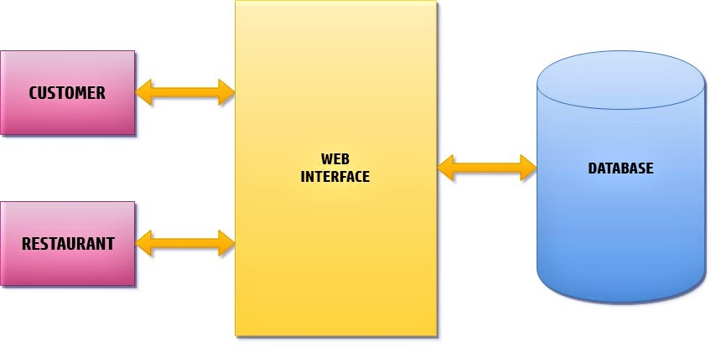
THE ARCHITECTURE OF THE APPLICATION

Slide 9
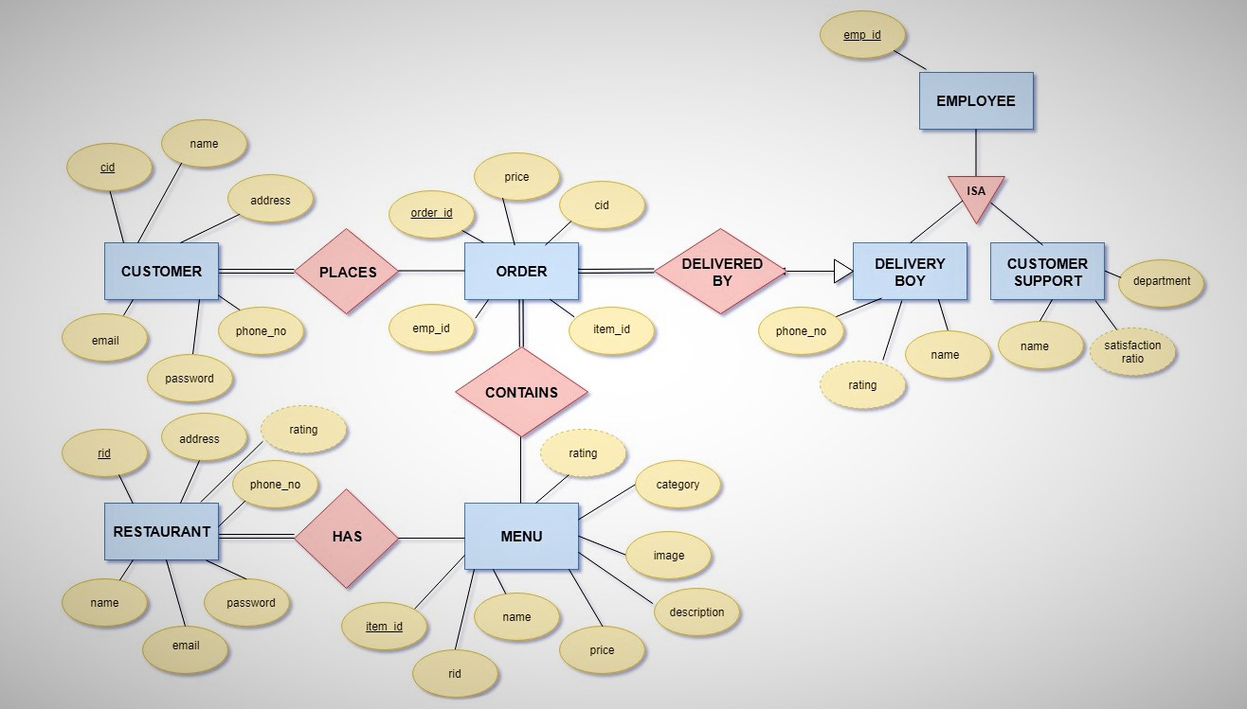
ER DIAGRAM

Slide 10
ENTITIES AND ITS ATTRIBUTES
Customer [Attributes -> cid, name, email, password, phone_no, address]
Restaurant [Attributes -> rid, name, email, password, phone_no, address,rating]
Menu [Attributes -> item_id, name, rid, price, description, image, category, rating]
Order [Attributes -> order_id, emp_id, item_id, cid, price]
Employee[Attributes ->emp_id]
Delivery_boy [Attributes -> emp_id, name, phone_no, rating]
Customer_support [Attributes -> emp_id, name, department, satisfaction_ratio]

Slide 11
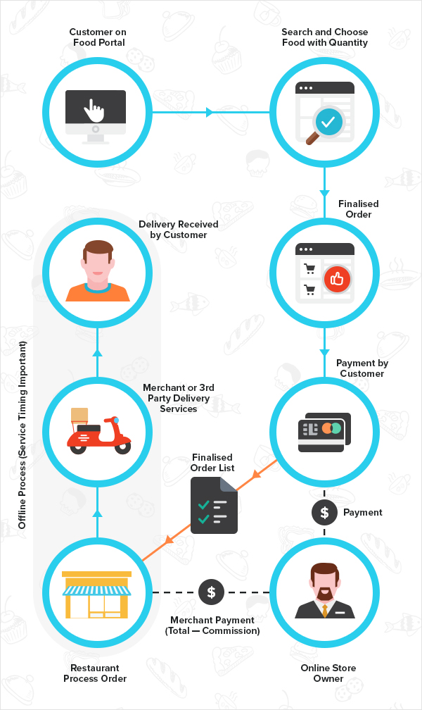
W
O
R
K
I
N
G

Slide 12
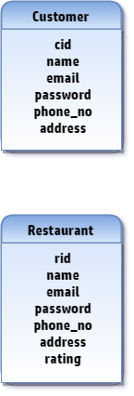
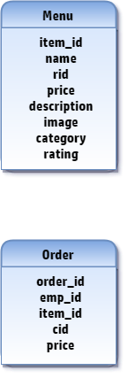


AFTER 1ST NORMAL FORM
cid -> email, password
email -> name, phone_no, address
Primary key = cid
${(item_id)}^{+}$= Menu
Primary key = item_id
rid -> email, password, phone_no, address
email -> name, rating
Primary key = rid
${(order_id)}^{+}$= Order
Primary key = order_id
Foreign key = emp_id,cid

Slide 13
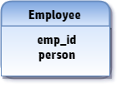
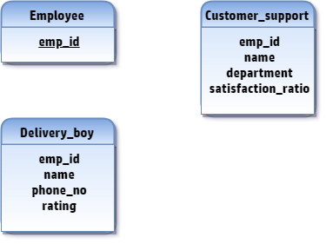


CONTD…
Primary key = emp_id
${(emp_id)}^{+}$= Customer_support
Foreign key = emp_id
${(emp_id)}^{+}$= Delivery_boy
Foreign key = emp_id

Slide 14

AFTER 2nd NORMAL FORM
cid -> email, password
email -> name, phone_no, address
Primary key = cid
${(item_id)}^{+}$= Menu
Primary key = item_id
rid -> email, password, phone_no, address
email -> name, rating
Primary key = rid
${(order_id)}^{+}$= Order
Primary key = order_id
Foreign key = emp_id,cid

Slide 15
CONTD…
Primary key = emp_id
${(emp_id)}^{+}$= Customer_support
Foreign key = emp_id
${(emp_id)}^{+}$= Delivery_boy
Foreign key = emp_id

Slide 16
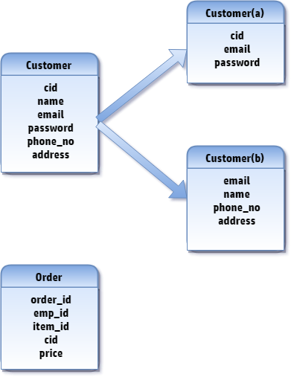
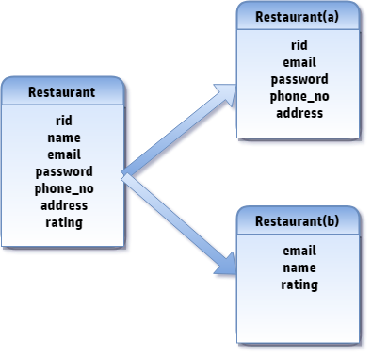
AFTER 3RD NORMAL FORM

Slide 17
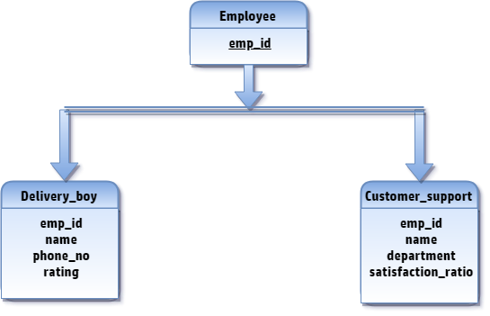
CONTD…

Slide 18

DEPENDENCY PRESERVING AND LOSSLESS JOIN
Dependency Preserving:
A Decomposition D = { R1, R2, R3….Rn } of R is dependency preserving with respect to a set F of Functional dependency if
${(\text{F}\text{1 }\text{υ} \text{F}\text{2 }\text{υ} \text{F}\text{3 }\text{υ}\text{ … }\text{υ} \text{F}m)}^{+}=$ ${(\text{F})}^{+}$

Slide 19

DEPENDENCY PRESERVING AND LOSSLESS JOIN
Lossless Join:
To check for lossless join decomposition using FD set, following conditions must hold:
Union of Attributes of R1 and R2 must be equal to attribute of R. Each attribute of R must be either in R1 or in R2.
Att(R1) $\text{υ}$ Att(R2) = Att(R)
Intersection of Attributes of R1 and R2 must not be NULL.
Att(R1) ∩ Att(R2) != NULL
3. Common attribute must be a key for at least one relation (R1 or R2)
Att(R1) ∩ Att(R2) = Att(R1)
OR
Att(R1) $Ո$Att(R2) = Att(R2)

Slide 20
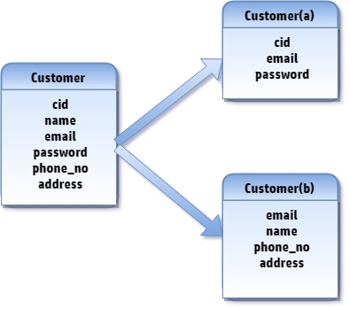
DEPENDENCY PRESERVING AND LOSSLESS JOIN
Here we have F = { cid -> email, password ; email -> name, phone_no, address }
As well as F1= {cid -> email, password } and F2 = { email -> name, phone_no, address }
We can clearly see that F1 ⋃ F2 = F , Hence shown table Customer is Dependency Preserving.
Here , Att(R) = {cid, name, email, password, phone_no, address }
Decomposed Tables have Att(R1) = {cid, email, password } and Att(R2) = {email, name, phone_no, address }
Acc. to Conditions for Lossless Join Att(R1) ⋃ Att(R2) = Att(R) and Att(R1) ⋂ Att(R2) = {email} , So table named Customer follows all conditions of Lossless Join.

Slide 21
DEPENDENCY PRESERVING AND LOSSLESS JOIN
Here we have F = { rid -> email, password, phone_no, address ; email -> name, rating }
As well as F1= {rid -> email, password, phone_no, address} and F2 = { email -> name, rating }
We can clearly see that F1 ⋃ F2 = F , Hence shown table Restaurant is Dependency Preserving.
Here , Att(R) = {rid, name, email, password, phone_no, address, rating }
Decomposed Tables have Att(R1) = {rid, email, password,phone_no, address } and Att(R2) = {email, name, rating }
Acc. to Conditions for Lossless Join Att(R1) ⋃ Att(R2) = Att(R) and Att(R1) ⋂ Att(R2) = {email} , So table named Restaurant follows all conditions of Lossless Join.

Slide 22
THANK YOU

